Slide 2
Robo PetDog
Bolt Presents…
NAVYA SINGH

Slide 3
NEED STATEMENT
It will respond to some human act. Sensing can be any human intervention. The response of the bot should mimic the actions of a dog. It should perform at least 3 different actions based on the gestures that will given as input. It should be of a small size and portable since it is a pet dogbot.
PROBLEM STATEMENT
We need to build a pet dog bot that can move and perform three tasks upon human interaction . We need to tackle the problem of slow sensors, the body movement, precision , Weight Balancing on the chassis , Scads of wires, coordinating the sensors , debugging the code , space management( there are a lot of stuff to be managed in quite a small space),covering the bot/final touch , use of IC and Soldering

Slide 4
Concept 1: This concept is the concept of the pet dog bot on wheels . Here , we will have two big wheels and one castor wheel , a metal body chassis for holding the stuff, an Arduino board, lots of wiring and coding ,cardboard platform extensions, a cardboard head, ultrasonic sensor, touch sensor, infrared sensors , a breadboard , two dc motors etc . This concept has prodigious locomotion capabilities.

Slide 5
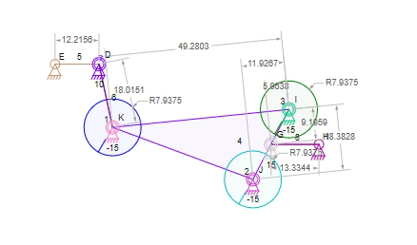
Diagram:

Slide 6
Concept 2: This concept is the concept of the pet dog bot on ice –cream sticks !!!!. Here , we will have lots of ice-cream sticks , soldering , oodles of mechanical calculation and physics involved , cardboard body (that too multilayered) an Arduino board, scad of wiring and coding ,cardboard platform extensions, a cardboard head, ultrasonic sensor, touch sensor, infrared sensors , a breadboard ,Only One dc motor for walking. This concept has LOTS of phenomenal indigenous ideas !

Slide 7
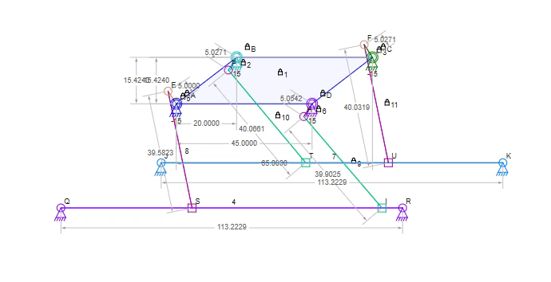
Diagram:

Slide 8
Concept 3: This concept is the concept of the pet dog bot on mechanical legs . Here , we will have four mechanical legs (all with one motor each), a metal body chassis for holding the stuff, an Arduino board, lots of wiring and coding ,cardboard platform extensions, a cardboard head, ultrasonic sensor, touch sensor, infrared sensors , a breadboard , Five servo motors etc . This concept comprises of extensive coding and code-breaking ideas ;)

Slide 9
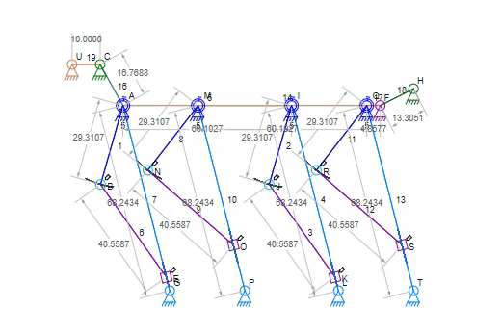
Diagram:

Slide 10
CRITERIA | WEIGHTAGE | CONCEPT 1 | CONCEPT 2 | CONCEPT 3
AESTHETICS | 4 | ++ | 0 | +++
COST | 6 | +++++ | 0 | +
EFFICIENCY | 3 | ++ | 0 | ++
REALISTIC IMPLEMENTATION | 5 | +++ | 0 | +
DURABILITY | 3 | ++ | 0 | +
LOCOMOTION | 2 | +++ | 0 | ++
USER INTERVENTION | 4 | + | 0 | +
SOLDERING | 5 | --- | 0 | -----
∑(+) |  | 75 | 0 | 40
∑(-) |  | 15 | 0 | 25
∑(Total) |  | 60 | 0 | 15

Slide 11
Final Concept: According to the pugh chart we are rolling with concept one i.e. the first concept . That is the one that we will be pursuing and if time permits we will upgrade our model to concept two and then three.

